Slide 1



Project HealthDesign: Common Platform
Enabling Innovative Uses of Health Data by Personal Health Applications
OSCON
Portland, Oregon
July 22, 2010
5:40pm – 6:00pm PDT
Samuel Faus
Sujansky & Associates, LLC

Slide 2
Project HealthDesign
Robert Wood Johnson Foundation (sponsor)
Capturing and integrating Observations in Daily Living (ODLs)
Phase 1 (2008) – 9 Grantees/PHAs
Sponsored Development of Common Platform
Notes:
Purpose of this proposal:
Background information on the v3.0 methodology for dynamic modeling
Proposal for a specific dynamic model for the ELINCS standard –> point of departure for working group discussion

Slide 3
What IS the Common Platform?
Personal Health Data Repository
  Storage & retrieval of personal health data from mobile/web-enabled devices and applications
SOAP-based Java web services architecture
Requirements gathered from the 9 grantees
Supports the operation/interoperability of PHAs
Notes:
Purpose of this proposal:
Background information on the v3.0 methodology for dynamic modeling
Proposal for a specific dynamic model for the ELINCS standard –> point of departure for working group discussion

Slide 4
Premise of the Common Platform
Many different PHAs require similar components and resources, including:
  Medication list management
  Recording of observations at home
  Safeguarding data
    Authentication
    Access control
  Identity reconciliation
Notes:
Purpose of this proposal:
Background information on the v3.0 methodology for dynamic modeling
Proposal for a specific dynamic model for the ELINCS standard –> point of departure for working group discussion

Slide 5
PHD Common Platform Architecture
Common Platform Server
Observation Service
Authentication Service
MySQL
Personal Health Applications
Personal Health Applications
Personal Health Applications
Registry Service
Access Ctrl Service
Medication Service
Public web-services interface
Private internal interface

Slide 6
Platform Features: Notable Items
Single sign-on
Flexible access control system
Mix of clinical data types and patient-centric ODLs
Extensible data types
Optional coding of data
Support for annotations and multi-media attachments
Notes:
Purpose of this proposal:
Background information on the v3.0 methodology for dynamic modeling
Proposal for a specific dynamic model for the ELINCS standard –> point of departure for working group discussion

Slide 7
Common Platform Data-Object Relationships
Patient
Medication List
Observations in Daily Living
Annotations
Attachments
Annotations
Attachments
User

Slide 8
Supported Data Types
Observation Service | Medication Service
General Observation | DispenseRecord
HealthCareEncounter | Prescription
JournalEntry | AdHoc
MealOrSnack
MedicationAdministration
ObservableParameter
PhysicalActivity
SignOrSymptom
Pain
Notes:
Purpose of this proposal:
Background information on the v3.0 methodology for dynamic modeling
Proposal for a specific dynamic model for the ELINCS standard –> point of departure for working group discussion

Slide 9
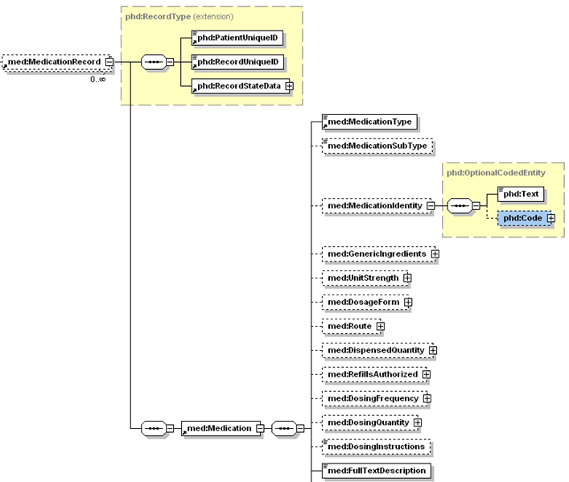
Example Data Type: MedicationRecord

Slide 10
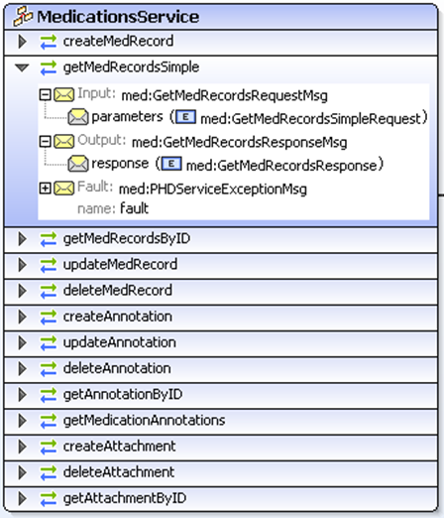
Supported Web Service Operations:
Medications Service

Slide 11
Access Control
Access Control for the Common Platform is:
  Role-based
  Hierarchical (operations, resources, roles)
  Centralized
Example Assertions
  “Anyone whom I designate as a family member may view all of my data, except for my journal entries and one of my personal medications…”
  “My primary physician, Dr. Smith, may view and modify my medication list and may view and annotate my observation data…”
Notes:
Purpose of this proposal:
Background information on the v3.0 methodology for dynamic modeling
Proposal for a specific dynamic model for the ELINCS standard –> point of departure for working group discussion

Slide 12
Lessons Learned
No authoritative source of ODL data types
PHAs strengthened by sharing of operational resources/data
Limited data types are sufficient
Flexible/powerful access control is key
An open source PHDR can be successfully implemented
Notes:
Purpose of this proposal:
Background information on the v3.0 methodology for dynamic modeling
Proposal for a specific dynamic model for the ELINCS standard –> point of departure for working group discussion

Slide 13
A Place for the Common Platform?
Academic Medical Institutions/Research Organizations
  Identify innovative ODLs through research
  Available resources to implement/expand on existing code-set
  Desire & ability to host data/services in-house
Start-ups
  Able to get product up & running with existing Common Platform infrastructure
  Can implement new features as needed/Replace
Notes:
Purpose of this proposal:
Background information on the v3.0 methodology for dynamic modeling
Proposal for a specific dynamic model for the ELINCS standard –> point of departure for working group discussion

Slide 14
Opportunities for Future Work
Encrypt ODL/Medication data in the database
Harden services against Denial of Service attacks
Added support for batch upload of data
Support for additional data-types
Develop platform-specific client API wrappers
Notes:
Purpose of this proposal:
Background information on the v3.0 methodology for dynamic modeling
Proposal for a specific dynamic model for the ELINCS standard –> point of departure for working group discussion

Slide 15
Accessing the Hosted Common Platform “Sandbox”
Hosted version of the Common Platform
NO REAL PATIENT DATA ALLOWED
Sign up for developer access through the Project HealthDesign website
http://www.projecthealthdesign.org/resources/common_platform/cde
Registration information is reviewed
Account is created and you are sent the user & application authentication information
Notes:
Purpose of this proposal:
Background information on the v3.0 methodology for dynamic modeling
Proposal for a specific dynamic model for the ELINCS standard –> point of departure for working group discussion

Slide 16
Accessing the Common Platform Source
Project HealthDesign website contains both source and binary distributable of the PHD Common Platform (including MySQL scripts and deployment guide)
Source
  Project_HealthDesign-CommonPlatform-SRC.zip
  http://bit.ly/aRLWGM
Binary Distributable
  Project_HealthDesign-CommonPlatform-BIN.zip
  http://bit.ly/cyvljw
Notes:
Purpose of this proposal:
Background information on the v3.0 methodology for dynamic modeling
Proposal for a specific dynamic model for the ELINCS standard –> point of departure for working group discussion

Slide 17
Additional Developer Resources
  Web Services Client Guide (http://bit.ly/949eca)
  Common Platform Components Summary (http://bit.ly/9yEejN)
Technical Specifications Overview (http://bit.ly/cB3PB5)
Technical Specifications Framework (http://bit.ly/drL4z4)
Functional Requirements (http://bit.ly/csQVhn)
Sample PHA Java Client Source (http://bit.ly/ce7R05)
Common Platform WSDL (http://platform.projecthealthdesign.org:8080/wsdl/HDServices.wsdl)
Notes:
Purpose of this proposal:
Background information on the v3.0 methodology for dynamic modeling
Proposal for a specific dynamic model for the ELINCS standard –> point of departure for working group discussion

Slide 18
Thank you.
Sujansky & Associates, LLC
sfaus@sujansky.com
www.sujansky.com

Slide 19
Additional Slides
Sujansky & Associates, LLC
www.sujansky.com

Slide 20
Platform Implementation: Specifications
API Specifications
  WSDL v1.0
  SOAP v1.0
Source Code Development
  Java EE 5
  JDK 1.6 (Java 1.6.0_03; Java HotSpot(TM) Client VM Java 1.6.0_03)
  GlassFish V2 (java app server)
  NetBeans IDE 6.0
Current Deployment Environment
  Linux (Ubuntu) -- Linux version 2.6.18-53.1.21.el5
  Sun Java System Application Server 9.1_01 (build b09d-fcs)
  Java HotSpot(TM) Client VM (10.0-b19) for linux-x86 JRE (1.6.0_04-b12)
  MySQL Version 5.0.22
Notes:
Purpose of this proposal:
Background information on the v3.0 methodology for dynamic modeling
Proposal for a specific dynamic model for the ELINCS standard –> point of departure for working group discussion

Slide 21
Access Control Rules
Role Relationships
( createRelationship )
Patient Rec ID Role User ID
P-12345 “RecordCustodian” U-1111
P-12345 “FamilyMember” U-3333
P-98765 “Physician” U-3333
2. Access Rules [May be assigned to a class of resources]
( createAccessRule )
Patient Rec ID Role Operation Resource Context Action
P-12345 “RecordCustodian” “AllOperations” “AllData” “AllApplications” “Grant”
P-12345 “FamilyMember” “RecordViewing” “AllHealthData” “AllApplications” “Grant”
P-12345 “FamilyMember” “RecordViewing” “JournalEntry” “AllApplications” “Deny”
P-12345 “FamilyMember” “RecordViewing” Med-4857932 “AllApplications” “Deny”

Slide 22
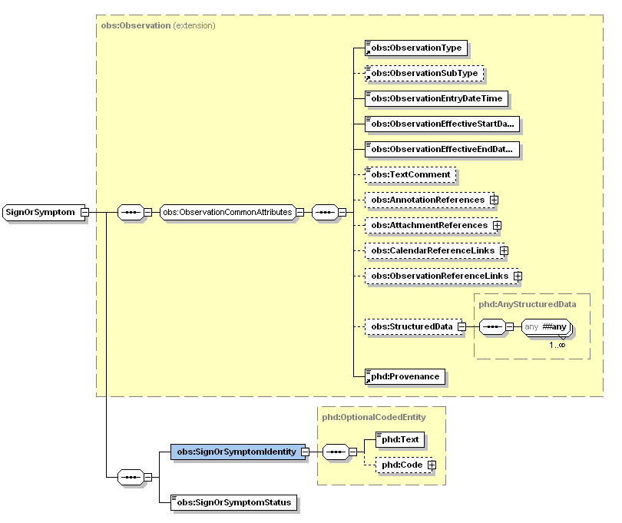
Clinical Data Types: Extensibility
Optional
Coding
22
Notes:
Purpose of this proposal:
Background information on the v3.0 methodology for dynamic modeling
Proposal for a specific dynamic model for the ELINCS standard –> point of departure for working group discussion

Slide 23
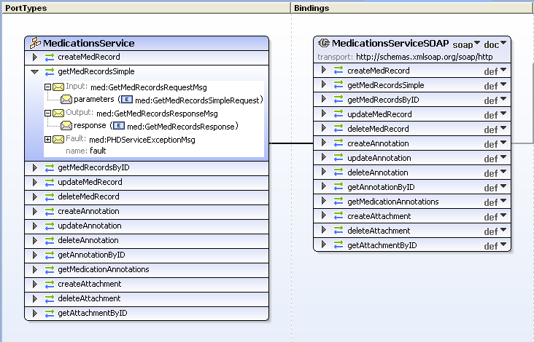
Distinct Handling of Annotations: Operations
23

Slide 24
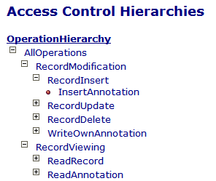
Distinct Handling of Annotations: Access Control
Allows writing of Record or Annotation
Allows writing of Annotation only
Allows reading of Record or Annotations
Allows reading of Record only

Slide 25
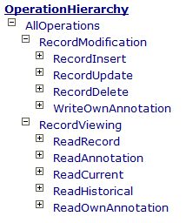
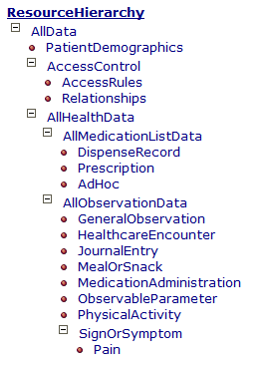
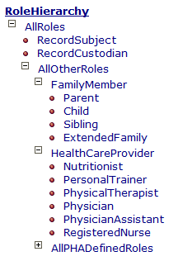
Access Control: Hierarchies
Notes:
Purpose of this proposal:
Background information on the v3.0 methodology for dynamic modeling
Proposal for a specific dynamic model for the ELINCS standard –> point of departure for working group discussion

Slide 26
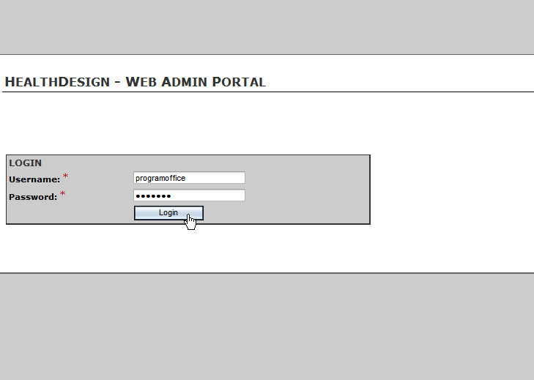
Sample PHA: Admin Portal
Notes:
Purpose of this proposal:
Background information on the v3.0 methodology for dynamic modeling
Proposal for a specific dynamic model for the ELINCS standard –> point of departure for working group discussion

Slide 27
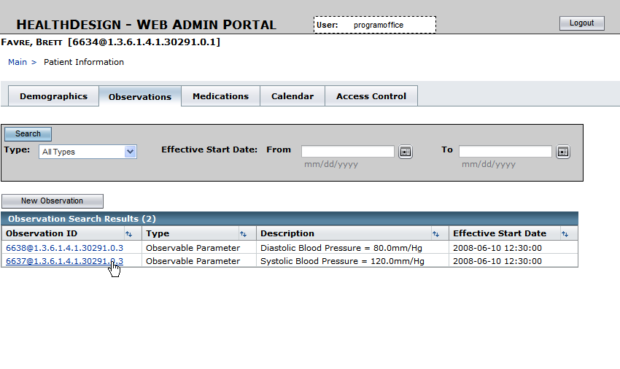
Sample PHA: Admin Portal
Notes:
Purpose of this proposal:
Background information on the v3.0 methodology for dynamic modeling
Proposal for a specific dynamic model for the ELINCS standard –> point of departure for working group discussion

Slide 28
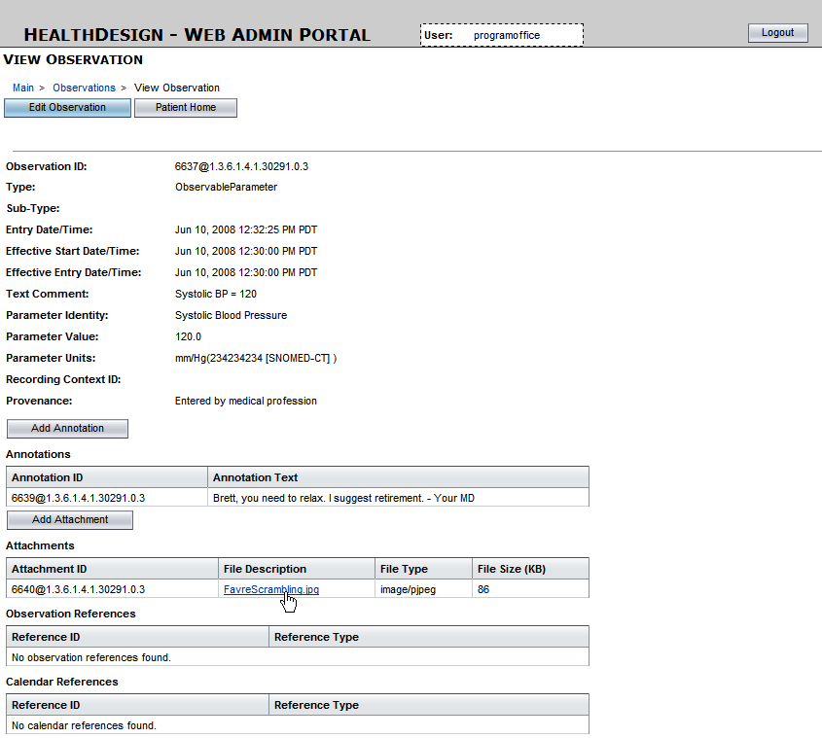
Notes:
Purpose of this proposal:
Background information on the v3.0 methodology for dynamic modeling
Proposal for a specific dynamic model for the ELINCS standard –> point of departure for working group discussion

